Slide 1
Data analysis

Slide 2
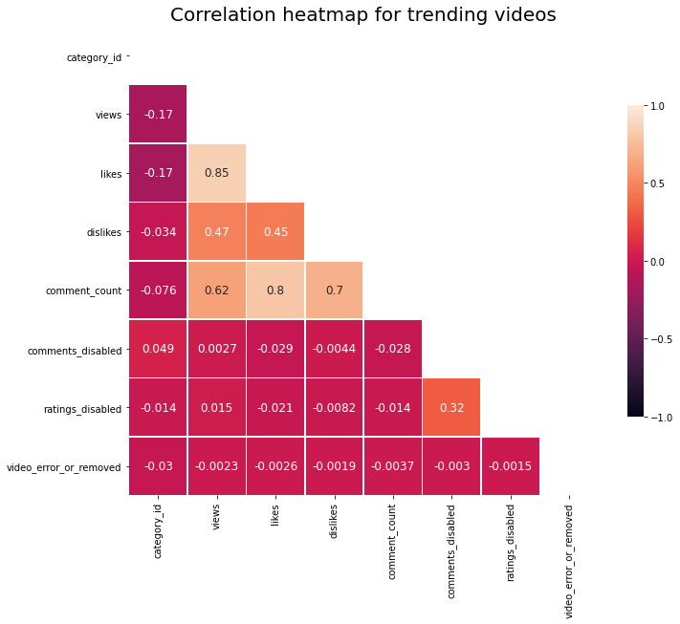

Slide 3
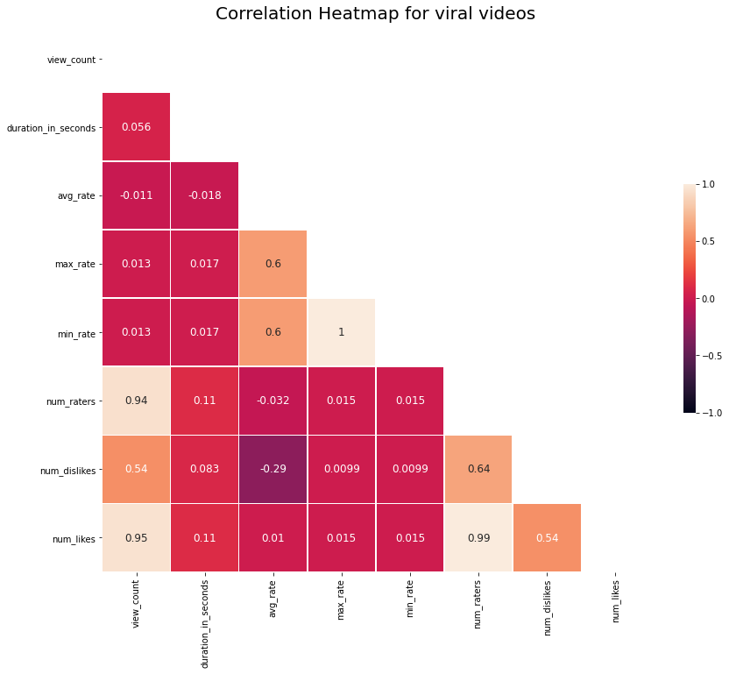

Slide 4
We are now interested in seeing how the different features of our datasets are correlated. This means evaluating the strength of a linear relationship between two quantitative variables. The closest values are to 1, the strongest positive relationship they have. It also works in the opposite, the closest values are to -1, the strongest the negative relationship. Values close to 0 means there is no relationship between the different variables.
We choose to do a correlation heatmap to understand how different features like views, likes, dislikes, comment count etc. are connected.
Our hypothesis: We imagine that the most views a video gets, the more likes, dislikes and comments it will get.
Our analysis:
On the trending dataset heatmap, the highest positive correlation is between likes and views with a value of 0.85.There is also a significant positive correlation between the number of comments and the number of likes (value of 0.8), and the number of comments and dislikes (value of 0.7). There is also a positive correlation yet less significant between the number of comments and views (value of 0.62), dislikes and views (0.47) and dislikes and likes (0.45).
Since there is a high positive correlation between between likes and views, we want to examine their relationship in greater depth by plotting a scatter plot between these variables.

Slide 5
For the viral dataset
In order to plot some more visualisations, we add two new features to the dataset: ‘publishing_day’ and ‘publishing_hour’ , created from the ‘upload_time’ feature.
Code used
df["publishing_day"] = df["upload_time"].apply(
lambda x: datetime.datetime.strptime(x[:10], "%Y-%m-%d").date().strftime('%a'))
df["publishing_hour"] = df["upload_time"].apply(lambda x: x[11:13])
For the trending dataset, we take the same steps as for the viral videos dataset .
We also replace the category ID by the corresponding category name, for example category_id 23 = ‘Comedy’ category. This will allow our visualisation to be easier to understand.
Code used:
# This creates a dictionary to hold a json file which has the info of categories
category_info={}
# by the help of this function we read the json file and then extract the data that we want to the dictionary
with open('.ipynb_checkpoints/US_category_id.json', 'r') as f:
data = json.load(f)
for category in data['items']
category_info[category["id"]]=category["snippet"]["title"]
print(category_info)
# To map category_id and category infos I'm converting category_id to string type
df['category_id']=df['category_id'].astype(str)
# I'm creating Category columns thanks to map func.
df['Category']=df['category_id'].map(category_info)
df['Category'].head()

Slide 6
The findings of our study have to be seen in light of their limitations. Indeed, although we wish it did not, our project presents methodological issues stemming from the datasets themselves, as well as our bias as researchers.. In this section, we want to discuss these limitations and acknowledge how they might impact our findings’ reliability. Only then can our conclusions be approached through an honest lens. We also suggest ways in which these shortcomings can be be addressed in the future, which might prove useful to aspiring data journalists aiming to improve this stuy.
The collection and selection of videos
A key limitation stems from the methods and the criteria adopted when selecting the videos in each dataset..
As the datasets come from different sources (c.f. ‘Our datasets’ section), the methods used to collect them are not the same. This means the features and the number of videos collected differ. This was a significant limitation when creating visualisations to compare virality and trendiness. For example, the Youtube Trending dataset does not include the ‘duration in seconds’ feature of the CMU (viral) dataset. As a consequence, we were unable to compare the length of trending and viral videos. Similarly, the CMU dataset does not include the number of tags used per video, present in the YouTube Trending algorithm.
Additionally, the datasets do not cover the same period of time. If the CMU dataset compiles viral videos from 2006 to 2011, our YouTube Trending datasets cover videos from YouTube Trending for 2017- 2018. As we have seen, the YouTube algorithm is ever changing so the characteristics favoured by the algorithm in 2018 would not have been the same as back in 2006. Furthermore, in this period of time, the numbers and demographics of YouTube watchers have changed, and so might have their interests and their way of interacting on the platform.
Another consequence of differing collection methods is that the way of categorising the datasets themselves varies. The YouTube Trending dataset is divided according to countries. On the other hand, the geographical area represented in the CMU dataset is not specified. However, because it was assembled from US sources , we assumed it best reflected viral videos in the US.
→ So what would an ideal dataset look like? In order to directly compare the viral and trending phenomena, the sample selected should cover the same time period geographical area, and include the same features. Furthermore, the collection of the data would be done by the same team of researchers for homogeneity.
Sample bias
If we set out with the aim of identifying the features of viral and trending videos, the datasets we used only reflect a part of the reality of these phenomena. Indeed, the insights we obtained only consider the characteristics of videos that have, indeed, gone viral, or trending, and not at the characteristics of the videos that did not. This is known as sample bias: we do not know for sure if the features identified a posteriori truly contribute to making a video popular.
How to remediate this sample bias? An analysis of the characteristics of videos that have not gone viral/trending or that share the same features as those that have, yet have not become viral/trending could be an interesting start to further research on the topic.
Researcher bias
If our study was relatively protected from bias related to our cultural backgrounds and beliefs, there is a fundamental bias we cannot change. All of us are (avid) YouTube users. If this proved useful for emitting our initial hypotheses, it is possible we were biased in our interpretation of the data.

Slide 7
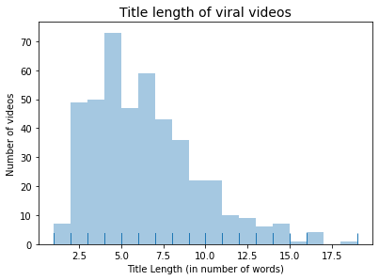

Slide 8
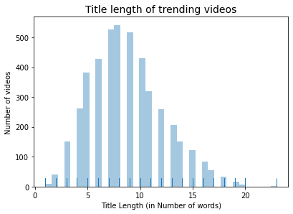

Slide 9
What is the most common title length(# of words)?
Trending
We can see that the title-length distribution resembles a normal distribution, where most videos have title lengths between approximately 5 and 13 words.
Viral

Slide 10
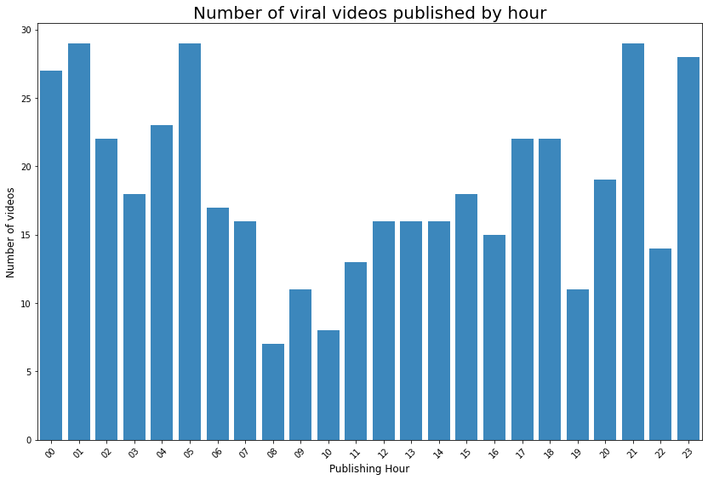

Slide 11
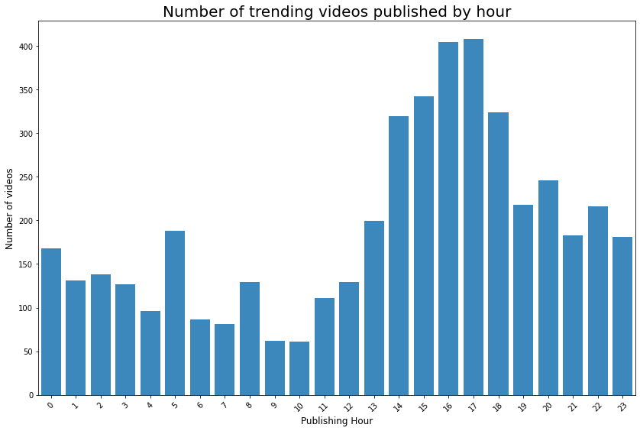

Slide 12
At which time of the day are most videos published?
Viral
Interesting results... a significantly large number of videos is published between 9pm and 1am, with another peak at 5am. But remember!this is UTC timezone. 9pm UTC corresponds to 4pm in Washington DC, USA. Therefore, in Washington time, the upload of videos reaches a peak at 4pm, and in the evening from 6 to 8pm. The other peak at 5am UTC corresponds to midnight on the West coast. The worst time to upload is bewteen 3-5am.
Trending
From the distribution plot, we see that most videos are uploaded in the mid afternoon around 3 and 4pm.

Slide 13
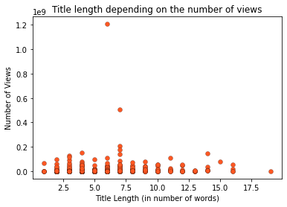

Slide 14
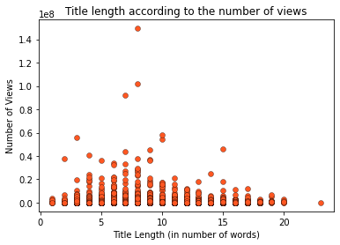

Slide 15
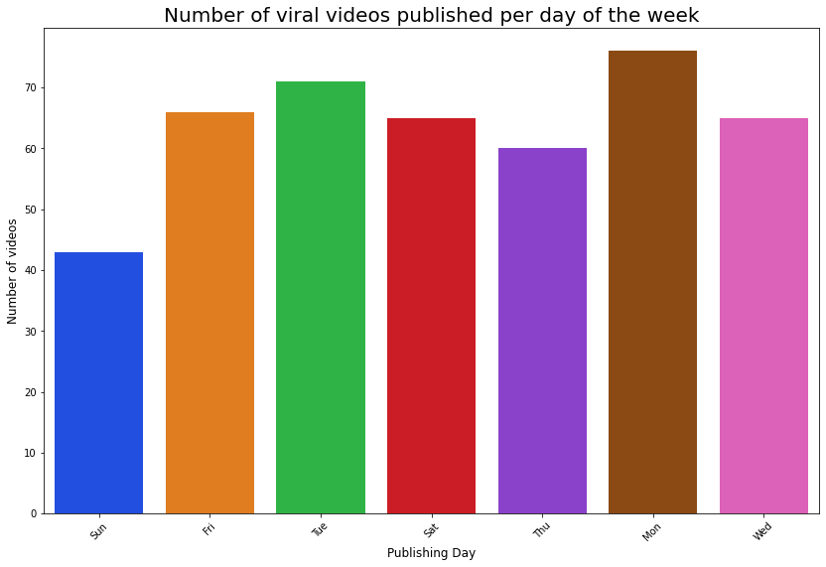

Slide 16
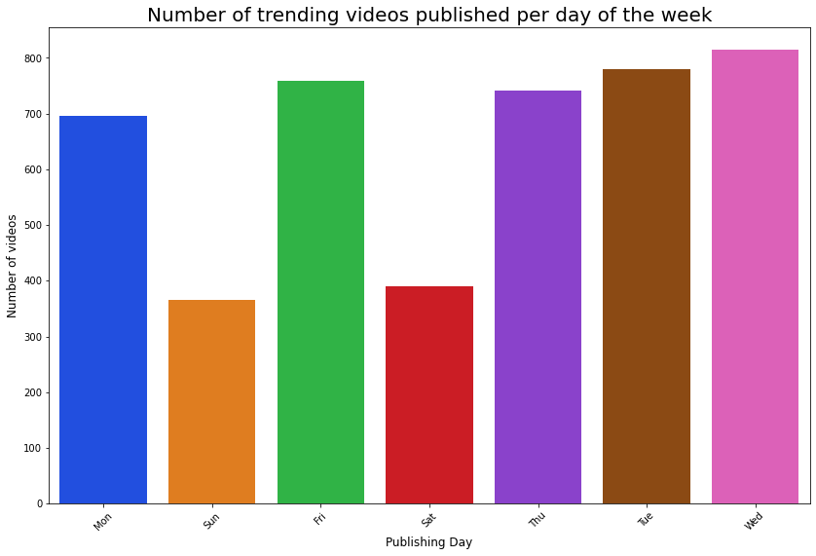

Slide 18
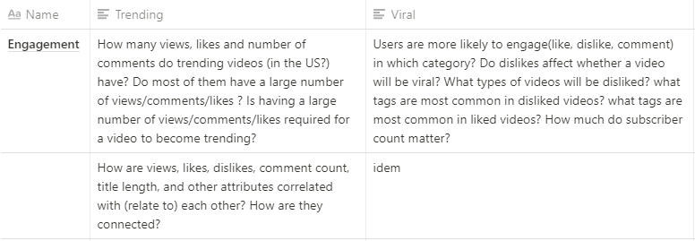

Slide 19
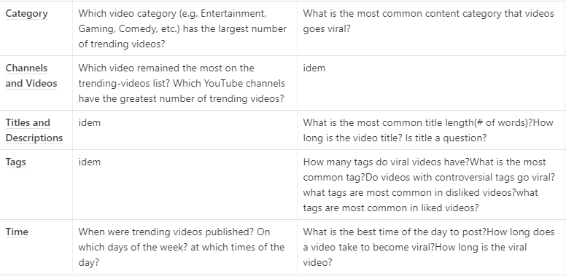

Slide 20
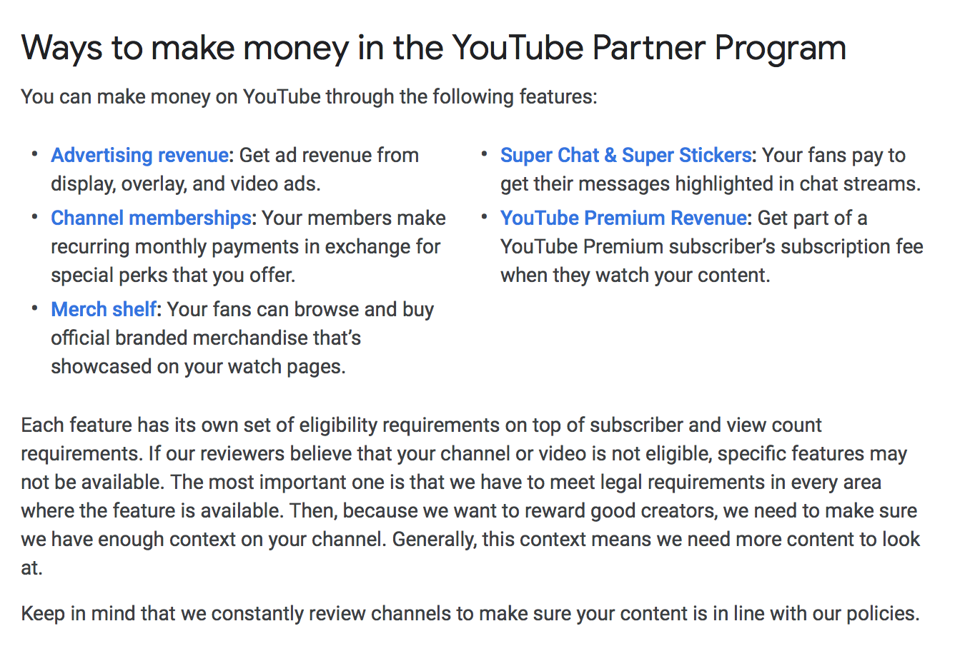

Slide 21
Viral dataset -
US only or world?
This dataset has ? videos

Slide 22
Our hypothesis: Viral videos can become viral whether they are massively liked or disliked, in other words viral videos are videos that create a reaction in the viewer.

Slide 23
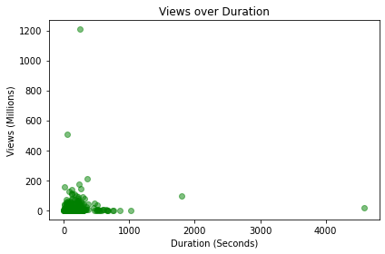
Notes:
keep

Slide 24
Why did we choose this visualisation:
We chose a scatter plot since it is the most effective way of visualising the information, and identifying clusters.
What can we see:
Cluster in bottom left
None greater than 16.6 min in duration
Most viral videos have a duration of 500 s or lower (8.33 min or lower)
What are the limitations:
Mention that views come after the video gets viral

Slide 25
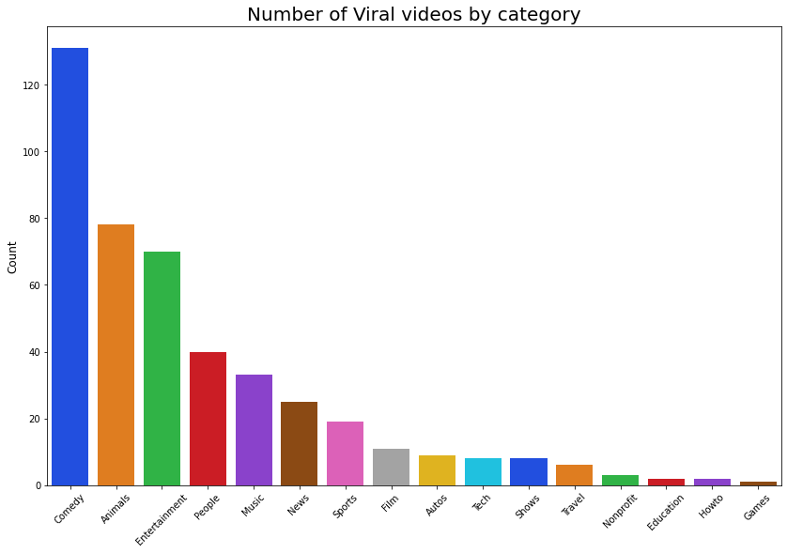
Note: this is the same as slide 5 but presented differently
Notes:
keep

Slide 26
Why did we chose this visualisation:
We chose a line graph to compare which categories have the most number of videos for trending and viral videos.
What can we see:
Top 3 categories: Comedy, Animals, Entertainment
Bottom 3 categories: Games, How to, Education
Viral video are funny
A video is more likely to go viral if its content is entertaining/fun/cute rather than pedagogical. One could argue it is easier for something “fun” to go viral: no debates/explications/need to focus required, quicker to share thus to go viral.
Animals category is very highly represented in viral videos, proportionally much more compared to trending videos.
‘How to’ and style category is almost not represented among viral videos, but is very high in the number of trending videos.
We hypothesise this is because of partnerships
What are the limitations:
Comedy and Entertainment categories are similar. Entertainment includes dance, talk shows.
Scale of line graphs is not the same, this is because there is not the same amount of videos in the viral and trending datasets.

Slide 27
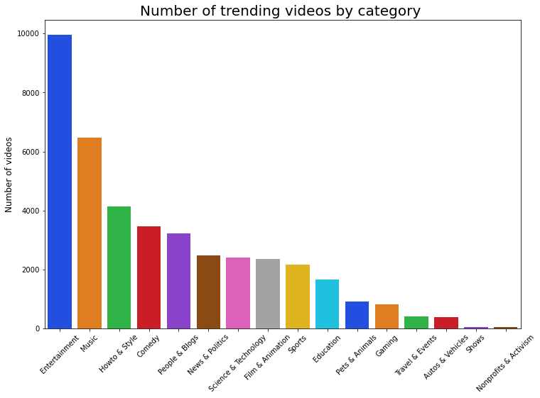
Note: this is the same as slide 15 but presented a bit differently
Notes:
keep

Slide 28
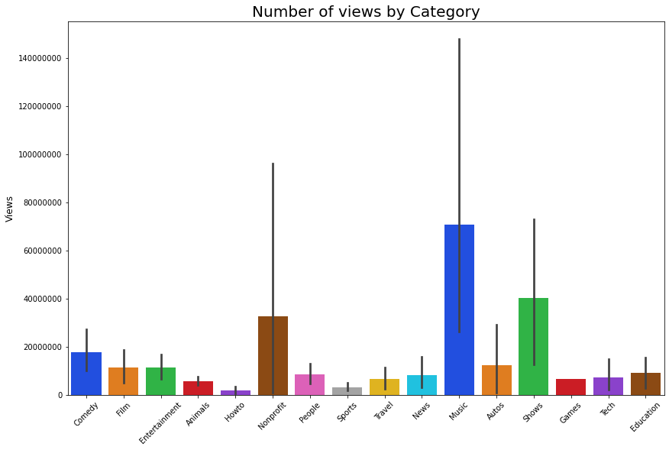
Note: same as slide 7

Slide 29
Why did we chose this visualisation:
What we can see:
The music category has the most views. This might be due to some of YouTube’s most viewed videos like Gangnam Style, belonging to that category, .
Shows have high numbers of views, although they do not have as many videos uploaded.
Non profit category also has high number of views.
What does the Nonprofit category mean? All non-remunerated videos, activism.
https://techpostplus.com/youtube-video-categories-list-faqs-and-solutions/
What are the limitations:

Slide 30
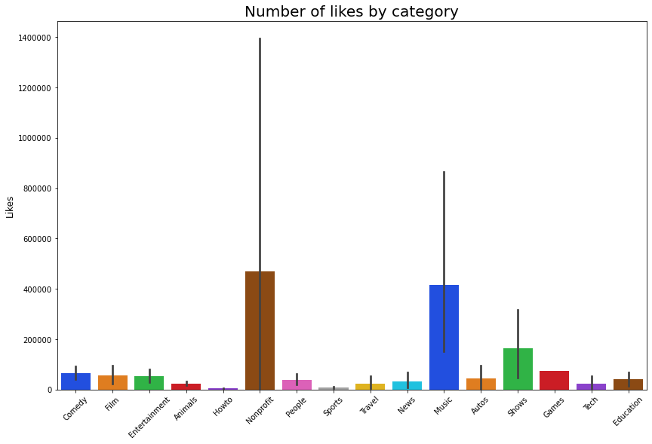

Slide 31
Why did we chose this visualisation:
What we can see:
What are the limitations:

Slide 32
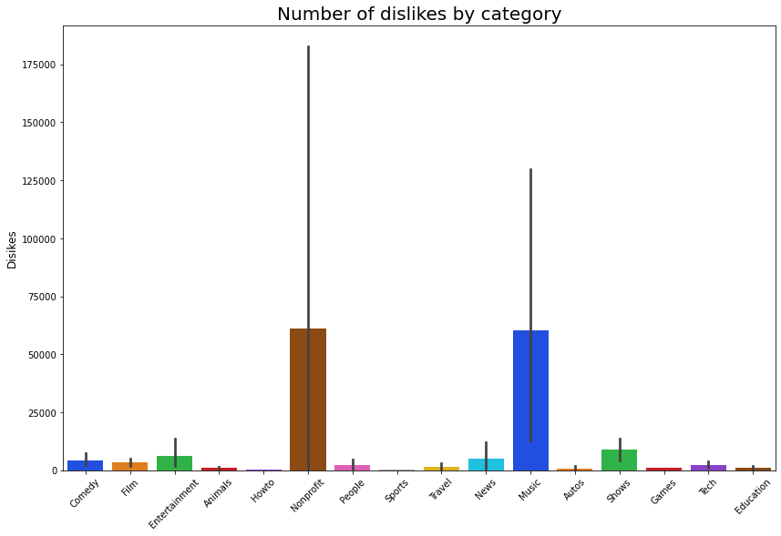

Slide 33
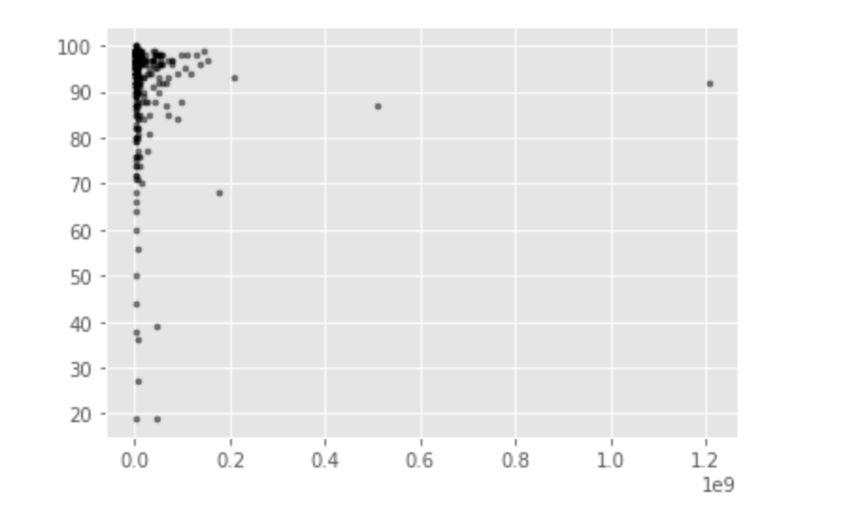
Viral
Number of Likes
Views

Slide 34
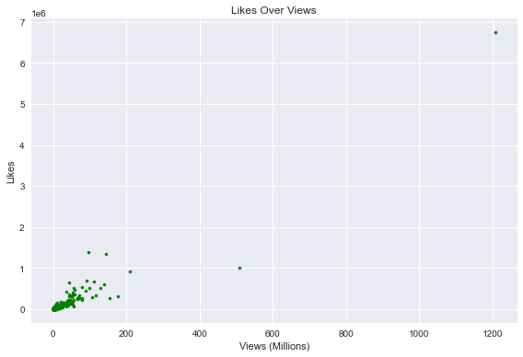
Viral

Slide 35
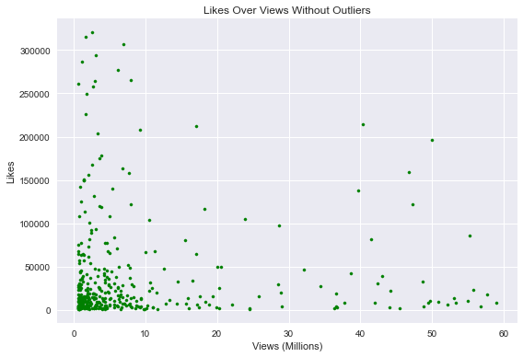
Viral
Notes:
Philippine

Slide 36
Following this, the percentage of likes was plotted against the views for the viral video’s dataset. Looking at it, a few things become clear. First of all, it is more than clear that the vast majority of the viral videos in the data set had an overwhelmingly high percentage of likes and therefore, a positive sentiment by the audience. More specifically, it seems as if the top videos in the viral dataset had around 95% of likes. These reached the millions of views. However, it should also be noted that those videos which didn’t go as viral (those with less than half a million views) did not all have a low percentage of likes. These are still accumulated between 90 and 80 % of likes. This emphasizes that though the majority of very viral videos had a very high percentage of likes, having a high percentage of likes does not guarantee virality. There is a random variable that the creator must take into account. Just because your video has a high and positive overall sentiment by the audience this does not guarantee virality. This is further highlighted by the equal distribution of the videos with less than one million views across the x-axis. However, looking at this the creator should note that if they have a low percentage of likes, their probability of going viral decrease greatly as no videos below a like percentage of 60% in the dataset attained more than 5 million views.

Slide 37
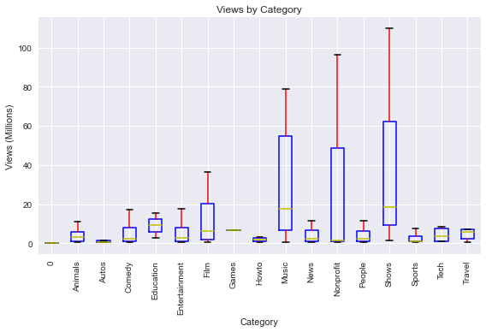
Jorge
Notes:
keep

Slide 38
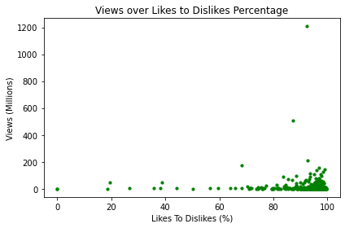
Notes:
keep

Slide 39
Why did we choose this visualisation:
What we can see:
Most viral videos have over 80% of likes, however some viral videos also have a majority of dislikes. So you can get viral with videos that create bad buzz, but we advise you to create videos that will have likes.
Most outliers (videos with the most views) still have over 80% of likes.
What are the limitations:

Slide 40
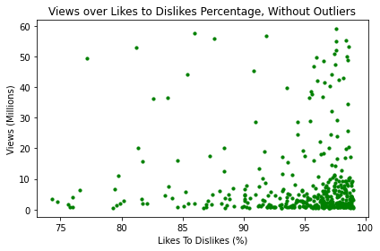

Slide 41
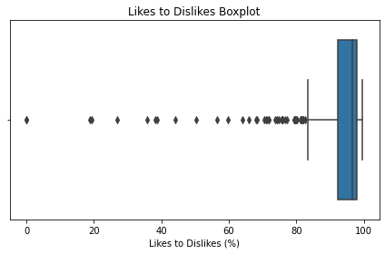
Notes:
keep

Slide 42
Why did we choose this visualisation: Boxplot is a good way to see the repartition of the data, as well as the outliers.
What we can see:
Here we notice the repartition is quite concentrated above 80% of likes, but there are still outliers (videos that had a particularly high percentage of dislikes)
Viral videos in general have more likes than dislikes.
.
What are the limitations:

Slide 43
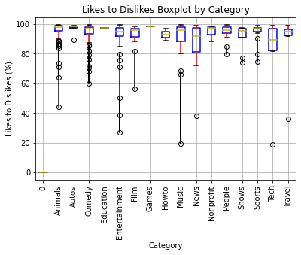
Notes:
keep

Slide 44
Why did we choose this visualisation: Boxplot is a good way to see the repartition of the data, as well as the outliers.
What we can see:
Entertainment and music have the greatest amount of outliers -> why?
.
What are the limitations:

Slide 45
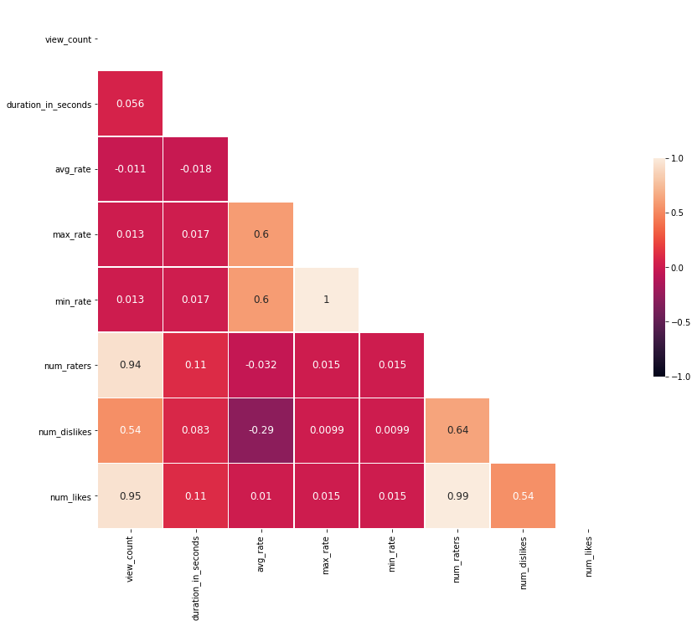
Notes:
keep

Slide 46
Why did we choose this visualisation: Boxplot is a good way to see the repartition of the data, as well as the outliers.
What we can see:
The highest positive correlation is between likes and views with a value of 0.85.There is also a significant positive correlation between the number of comments and the number of likes, and the number of comments and dislikes.
There is a positive correlation yet less significant between the number of comments and views, dislikes and views and dislikes and likes.
Since there is a high positive correlation between between likes and views, we want to examine their relationship in greater depth by plotting a scatter plot between these variables.
What are the limitations

Slide 48
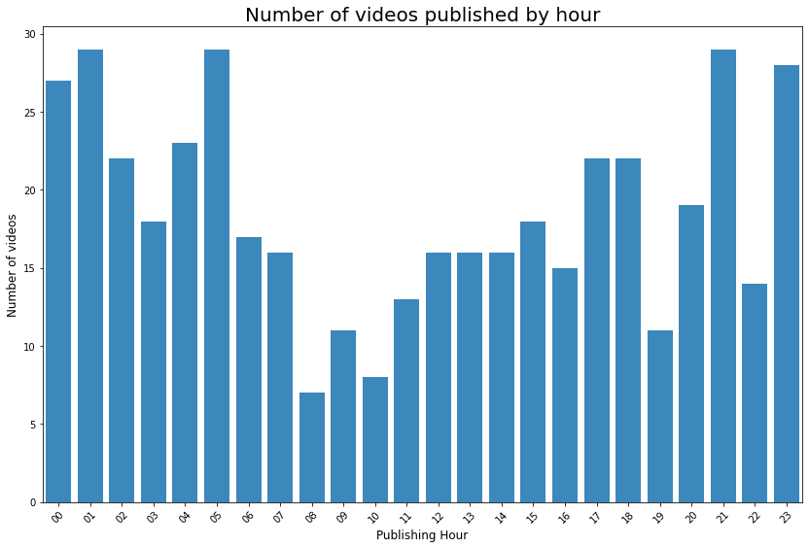

Slide 49
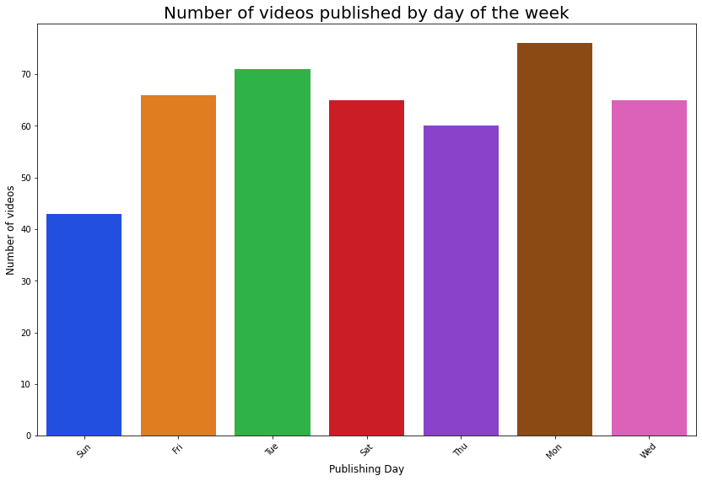

Slide 50
Trending Dataset (1)
US only
This dataset has 40949 videos

Slide 51
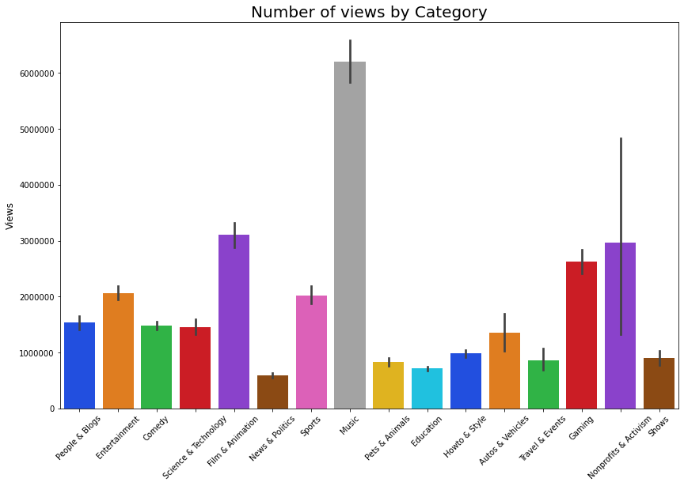

Slide 52
We observe that the number of views is much more equally distributed across categories.
The categories watched in trending videos are more varied than in viral videos. We hypothesise that this is due to the YouTube algorithm selecting videos to become trending among all categories.

Slide 53
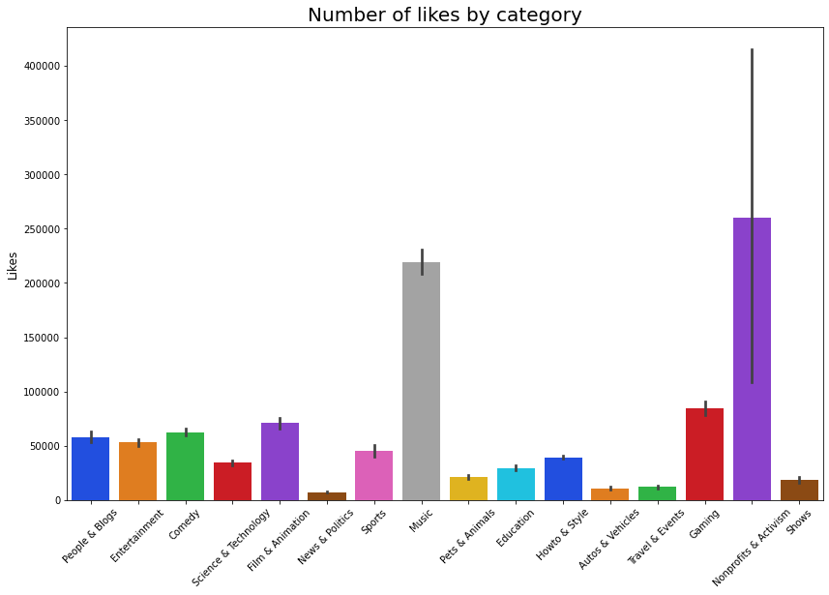

Slide 54
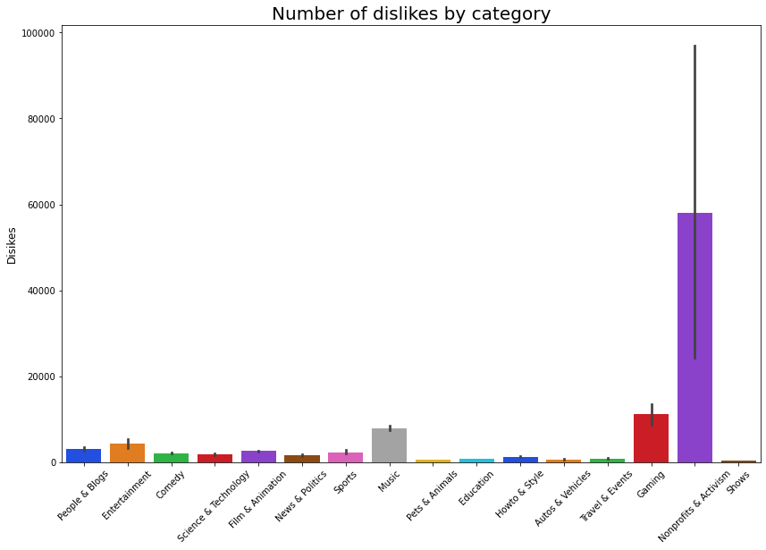

Slide 55
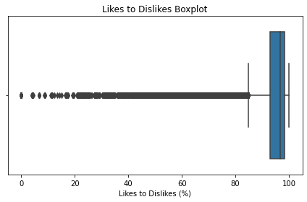

Slide 56
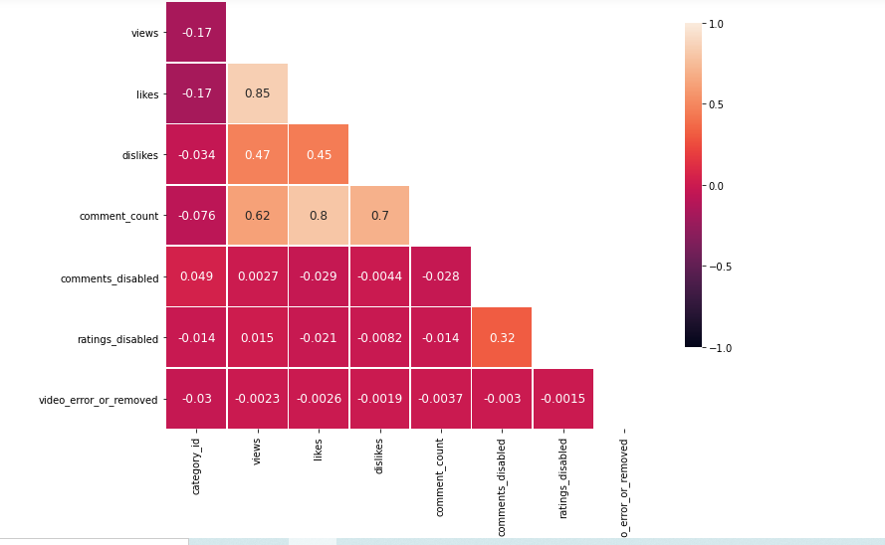
Correlation heatmap for the US trending videos
The highest positive correlation is between likes and views with a value of 0.85.There is also a significant positive correlation between the number of comments and the number of likes, and the number of comments and dislikes.
There is a positive correlation yet less significant between the number of comments and views, dislikes and views and dislikes and likes.
Since there is a high positive correlation between between likes and views, we want to examine their relationship in greater depth by plotting a scatter plot between these variables.
Notes:
The highest positive correlation is between likes and views with a value of 0.85.There is also a significant positive correlation between the number of comments and the number of likes, and the number of comments and dislikes.
There is a positive correlation yet less significant between the number of comments and views, dislikes and views and dislikes and likes.
keep

Slide 57
Trending Dataset (2)
US only
This dataset has 4547 trending videos

Slide 58
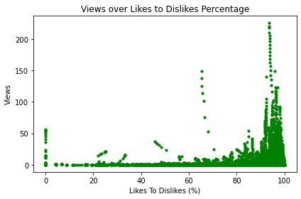

Slide 59
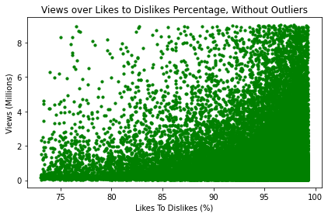

Slide 60
Compared to the viral one, we can see with this scatter plot that the percentage of likes is more varied. There isn’t a cluster from 80, but more of a block that starts at 70% and rises. This means that as the percentage of likes increases, so does the number of views.

Slide 61
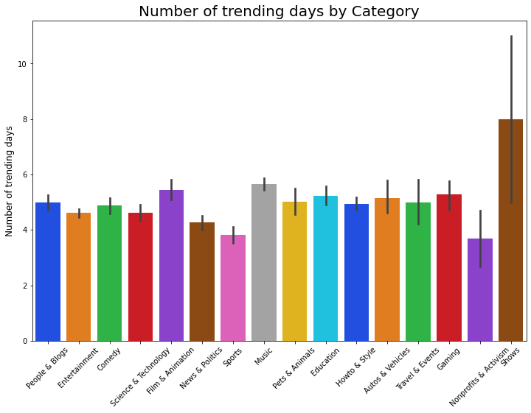

Slide 62
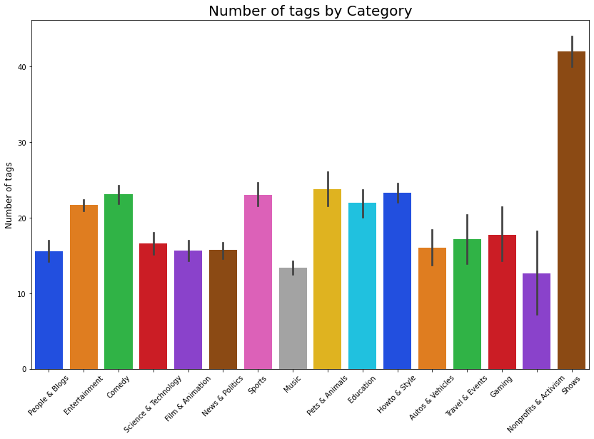

Slide 63
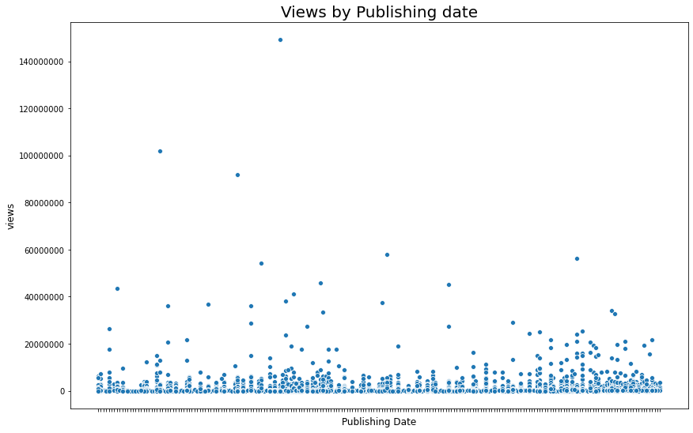
To edit for greater clarity

Slide 64
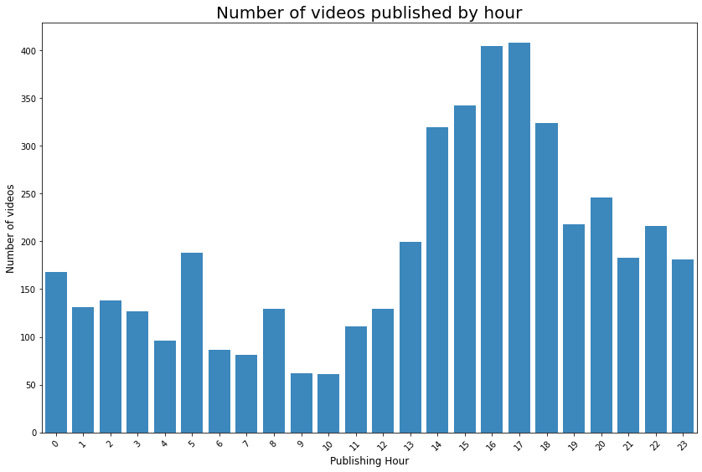

Slide 65
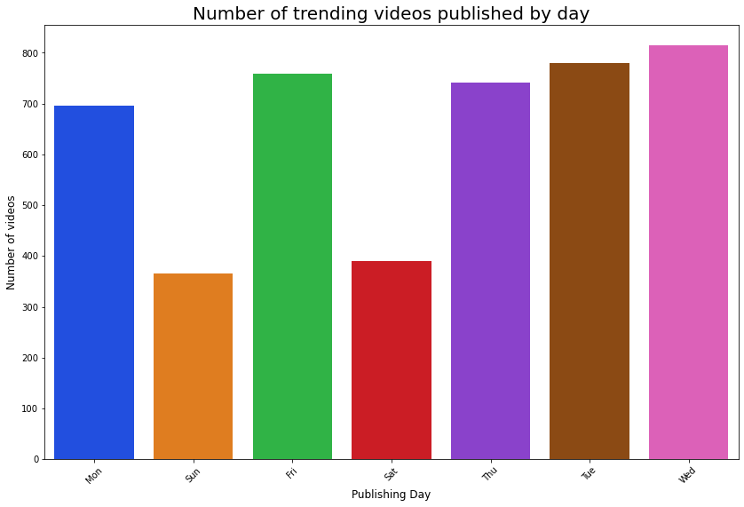

Slide 66
